Slide 1
Resume Classification

Slide 2
Project By
Kesha Rasagna
Makineni Sai Ravali
Charishma Kurapati
Syed Saad Ahmer
Thotakura Venkatesh
Veduruparthi VamsiPrakash

Slide 3
Summary
Introduction
EDA
Model Building
Model Deployement

Slide 4
Introduction
Overview:
Resume classification involves using machine learning techniques to automatically categorize resume based on job requirements This helps streamline the recruitment process by quickly identifying suitable candidates from a large pool of applicants.
Objective:
The goal is to build a machine learning model that can classify resumes into predefined categories, making the recruitment process more efficient and less biased.
Scope:
The presentation will cover three main areas: Exploratory Data Analysis (EDA), model building, and deployment. Each section will delve into the methodologies, tools, and best practices involved.

Slide 5
Exploratory Data Analysis (EDA)
Exploratory Data Analysis (EDA) is a critical step in the data analysis process. It involves analyzing the main characteristics of the data set, often visualizing the data, to understand its structure, discover patterns, spot anomalies, and check assumptions before applying more advanced statistical methods or machine learning algorithms.
EDA helps in:
Summarizing the dataset: By using descriptive statistics to get insights into the data, such as mean, median, mode, variance, and standard deviation.
Visualizing the data: Employing plots like histograms, bar charts, box plots, scatter plots, and heatmaps to get a better understanding of the distribution and relationships in the data.
Identifying outliers and anomalies: Detecting unusual data points that might indicate data entry errors or significant insights.
Handling missing values: Understanding the nature and extent of missing data to decide on appropriate methods for dealing with them, such as imputation or removal.
Checking assumptions: Verifying the assumptions related to the data, like normality and homoscedasticity, which are important for many statistical models.

Slide 6
Techniques
Univariate Analysis: Examining each variable individually to understand its distribution, central tendency, and variability. Common methods include histograms, box plots, and frequency tables.
Bivariate Analysis: Analyzing the relationship between two variables using scatter plots, correlation coefficients, and cross-tabulations.
Handling Missing Values: Identifying and addressing missing data through techniques such as imputation, deletion, or using algorithms that can handle missing values.
Outlier Detection: Identifying unusual data points that can skew the analysis. Techniques include using z-scores, IQR methods, and visual inspections via box plots.

Slide 7
Tools
Python libraries like Pandas for data manipulation, Matplotlib and Seaborn for data visualization, and NumPy for numerical operations

Slide 8
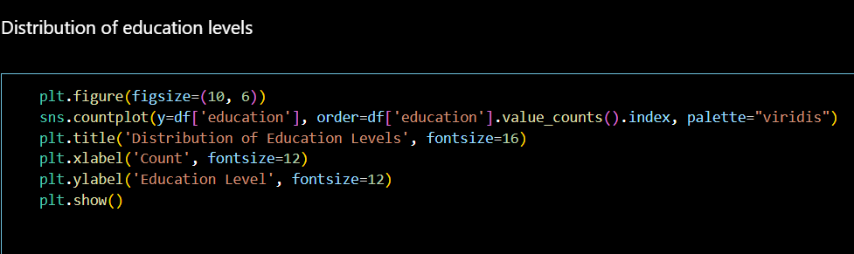
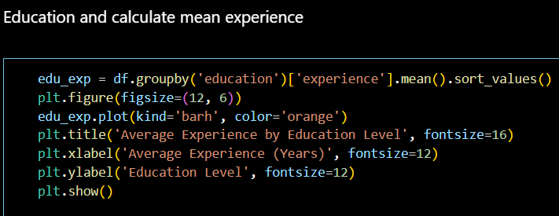
EDA Code
Education Level
Mean Experience

Slide 9
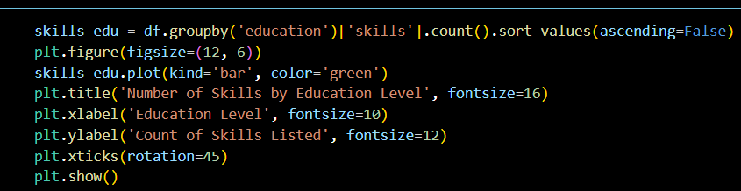
Education Level
Skills Count

Slide 10
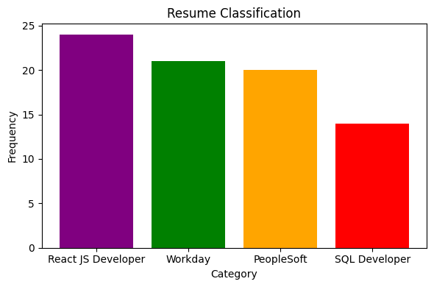
Category

Slide 11
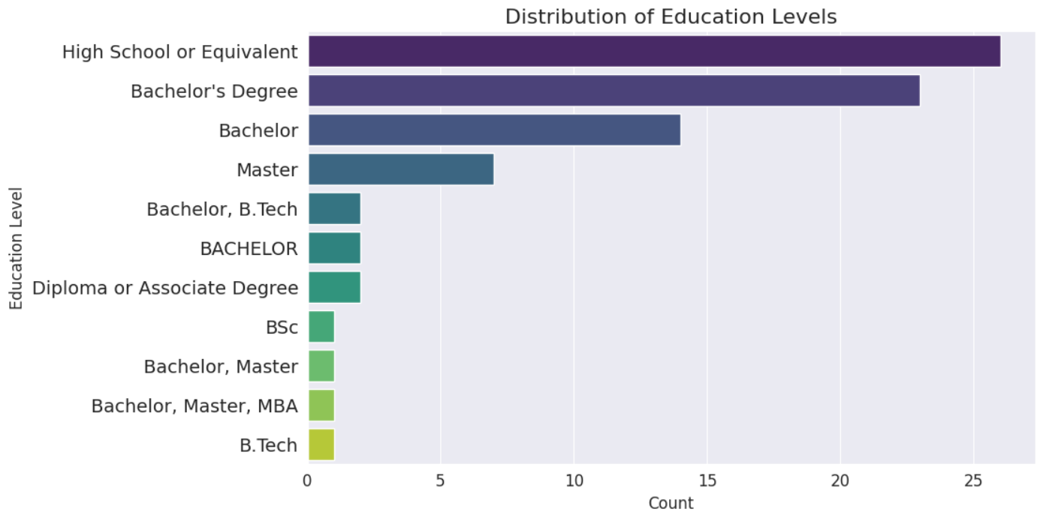
Output Distribution Of Education Level

Slide 12
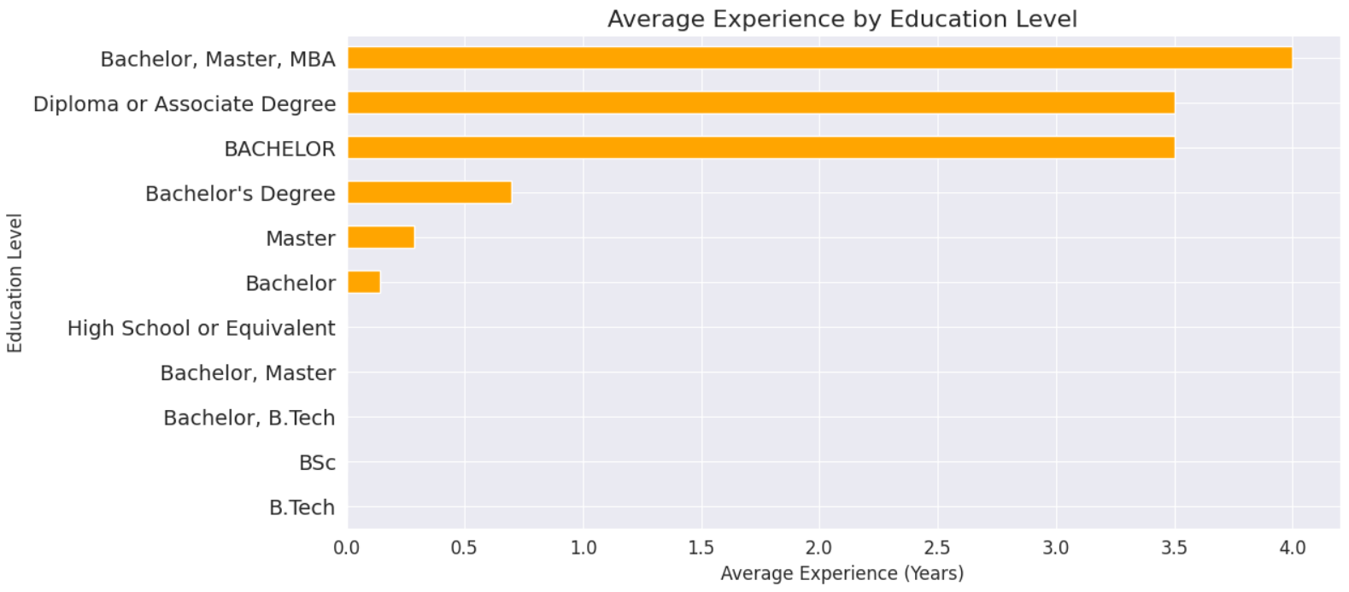
Output Average Experience By Education Level

Slide 13
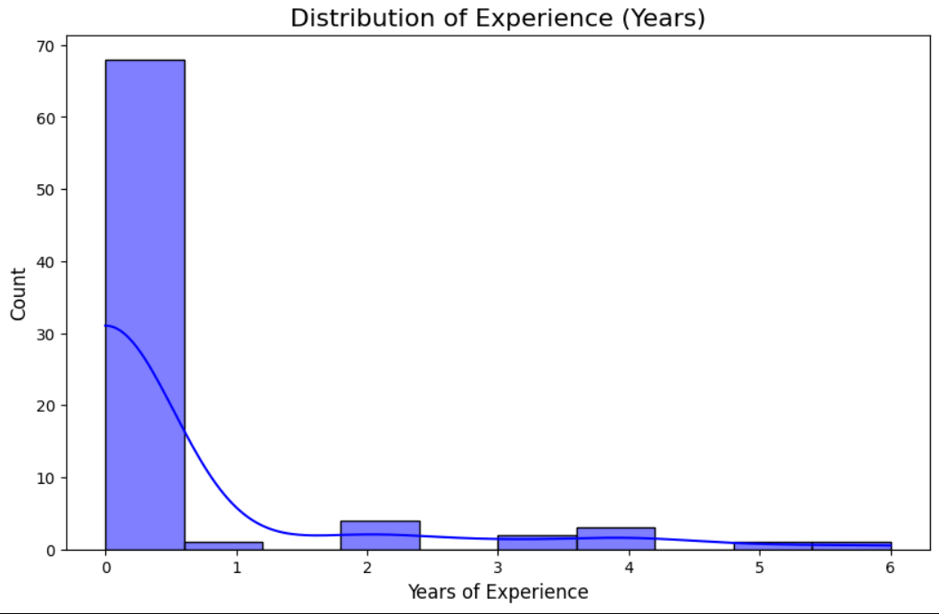
Output Experience Years

Slide 14
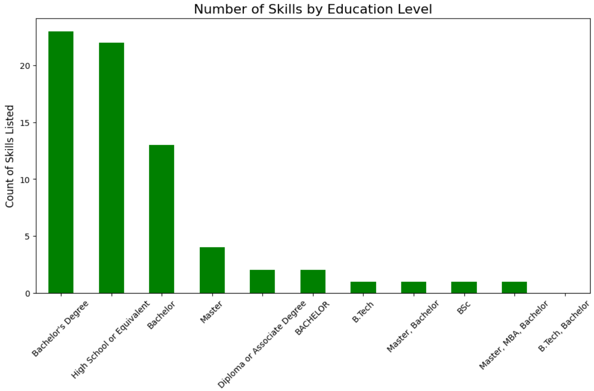
Output Number Of Skill By Education Level

Slide 15
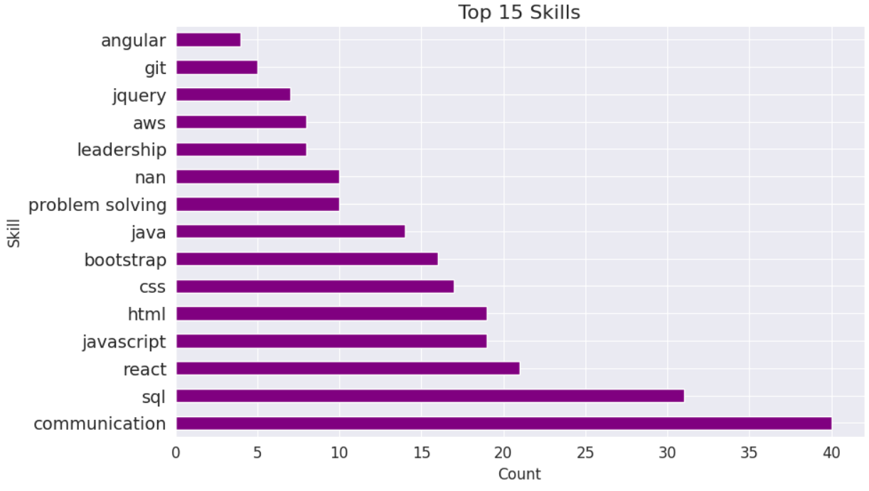
Output Top Skills

Slide 16
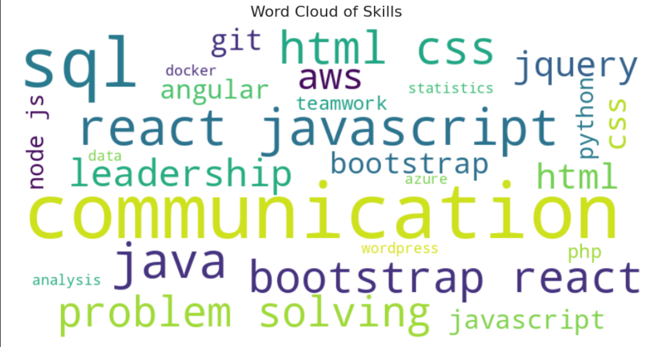
Output Word Cloud

Slide 17
Model Building
Data Preprocessing:
Cleaning:
Removing duplicates, fixing data entry errors, and standardizing formats.
Normalization:
Scaling features to ensure they contribute equally to the model, usually done via techniques like min-max scaling or z-score normalization.
Feature Engineering:
Creating new features from existing data to improve model performance. Examples include extracting keywords from resumes or creating binary indicators for specific skills.

Slide 18
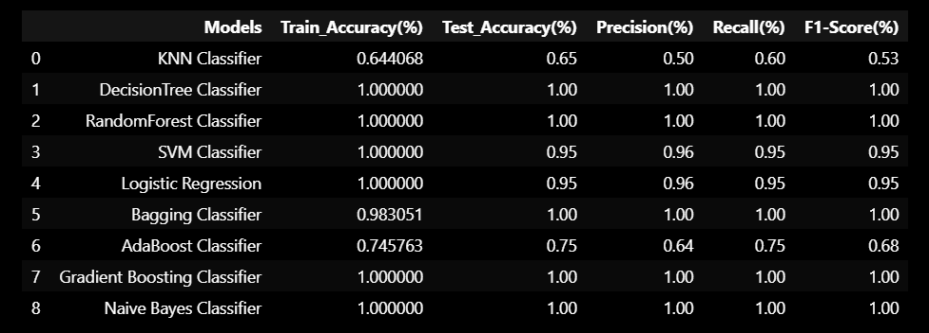
Model Evaluation Table

Slide 19
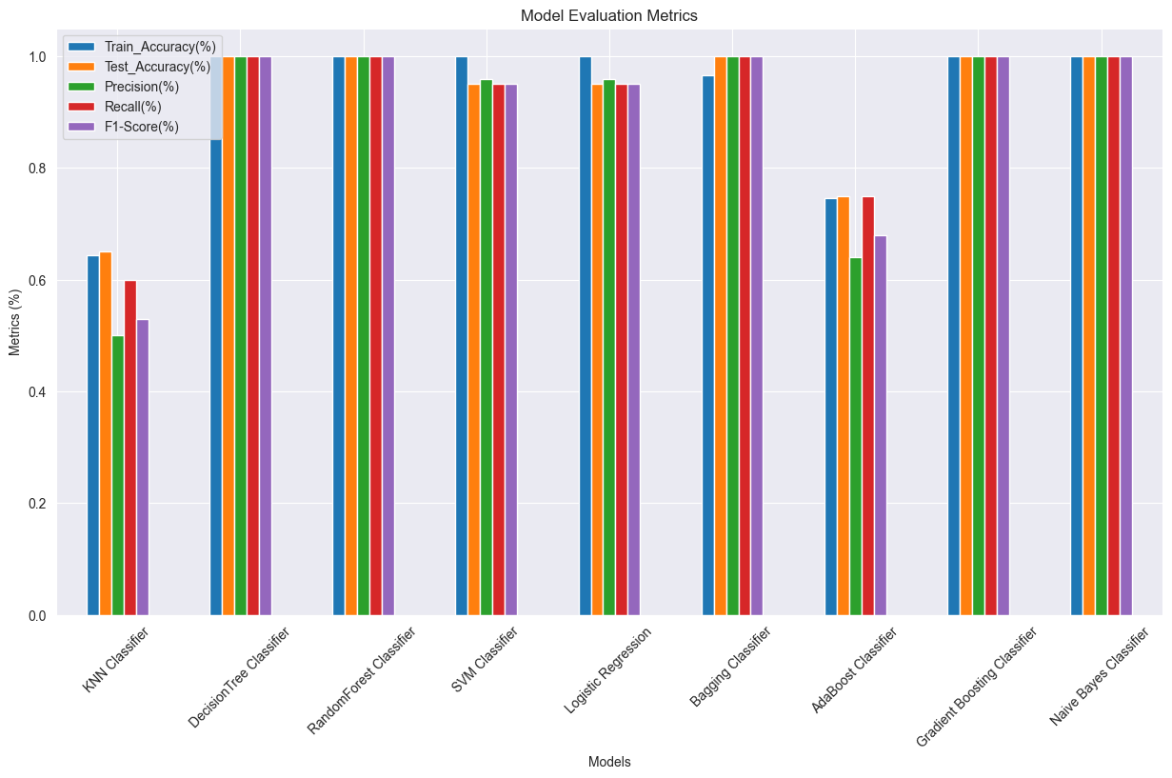
Model Evaluation Metrics

Slide 20
Model Selection
Algorithms:
Common choices for text classification include Naive Bayes, Support Vector Machines (SVM), and Neural Networks. The choice depends on the dataset size,complexity, and performance requirements.
Vectorization:
Converting textual data into numerical form using techniques like TF-IDF (Term Frequency-Inverse Document Frequency) or word embeddings.

Slide 21
Training and Test
Training:
Fitting the model to the training data using supervised learning techniques.
Validation:
Assessing the model's performance on unseen data using cross- validation, which helps in tuning hyperparameters and preventing overfitting.
Evaluation Metrics:
Metrics like accuracy, precision, recall, and F1-score to evaluate model performance.

Slide 22
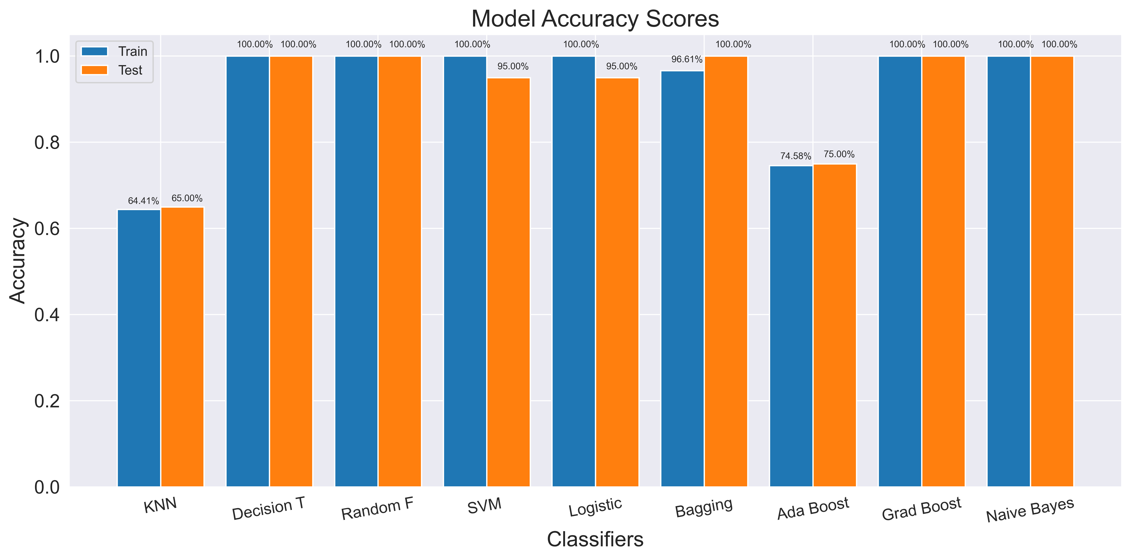
Model Accuracy Score

Slide 23
Model Deployment Streamlit
Introduction to Streamlit:
Start with a brief introduction to Streamlit. Streamlit is an open-source Python library specifically designed for creating and sharing beautiful, custom web apps for machine learning and data science.
Purpose:
Explain the purpose of using Streamlit. It simplifies the process of creating interactive applications for data scientists and machine learning engineers, allowing them to build powerful tools and dashboards without needing extensive knowledge of web development.

Slide 24
Key Features
Simplicity:
Streamlit is easy to use and allows for rapid development.
Integration:
It integrates seamlessly with popular ML libraries like TensorFlow,PyTorch, and scikit-learn.
Interactivity:
Provides interactive widgets to visualize data and results.
Deployment:
Facilitates easy sharing and deployment of ML models as web applications.

Slide 25
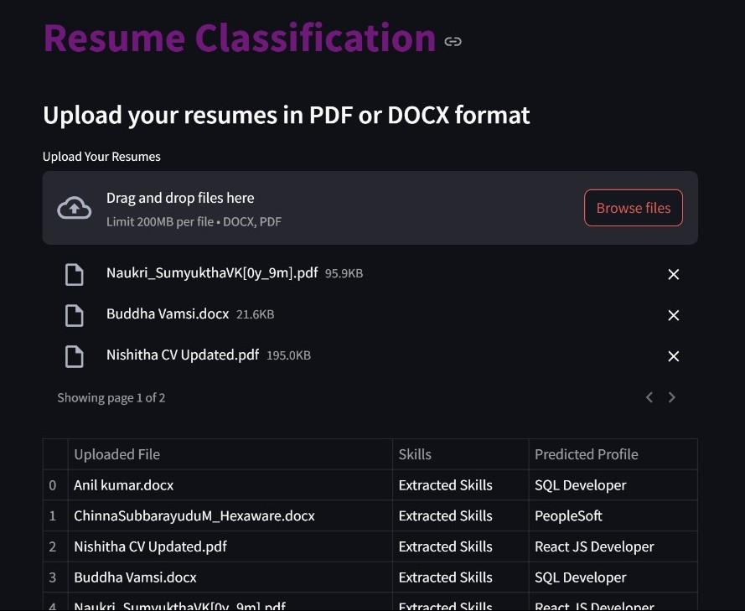
Output Streamlit Deployement

Slide 26
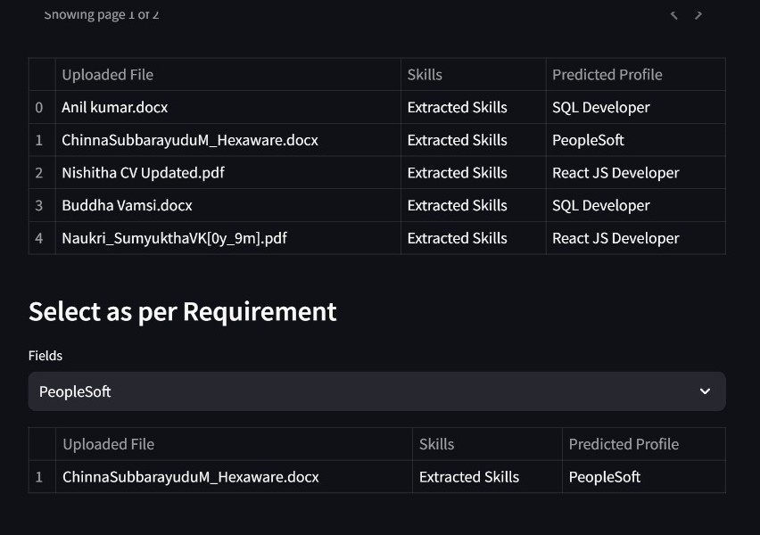

Slide 27
Thank you

